Slide 1
The Pennsylvania Horticultural Society motivates people to improve the quality of life and create a sense of community through horticulture.
Notes:
Thank you for attending this webinar/training. This is the fourth module of the series.

Slide 2
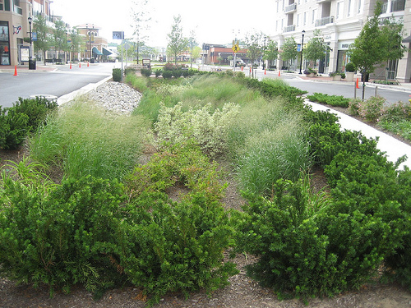
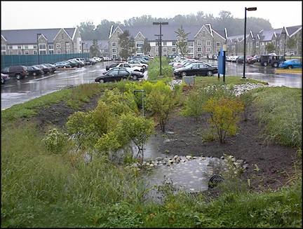
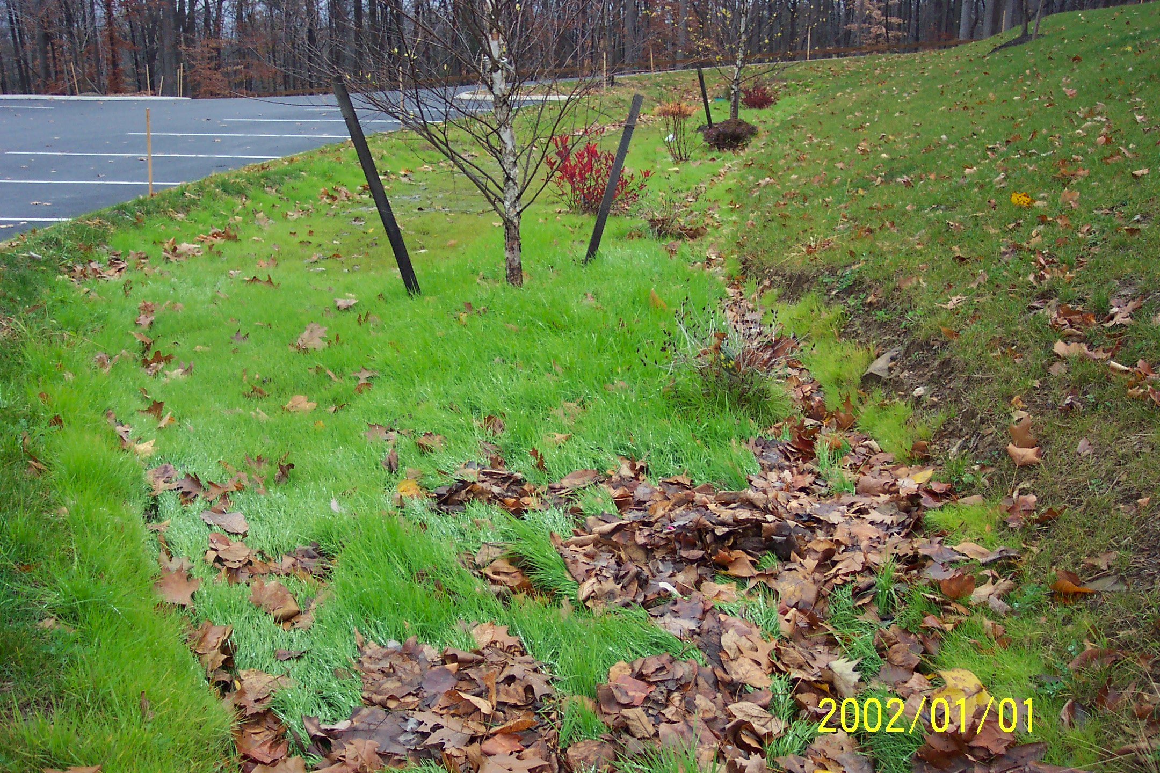
Maintaining Green Infrastructure Systems
Sustaining green stormwater infrastructure through proper landscape management
Managing weeds and invasive plants
Emma Melvin
PHS Regional Project Manager
Notes:
PHS has developed this series of six training modules, through grant funding from EPA Region III, in order to help clarify appropriate maintenance techniques for Green Stormwater Infrastructure practices (GSI). It is our hope that the information included here will be helpful for anyone who is learning about SBMPs or is training others about properly maintaining the practices.
As a review: there are two bio-retention system types:
dry systems including porous pavement, greenroofs, bio-retention (rain gardens, tree trenches, bio-swale) and
wet systems - constructed wetlands.
We have focused our trainings on the most commonly installed practices for bio-retention, but much of the same maintenance practices occur on all of the systems.

Slide 3
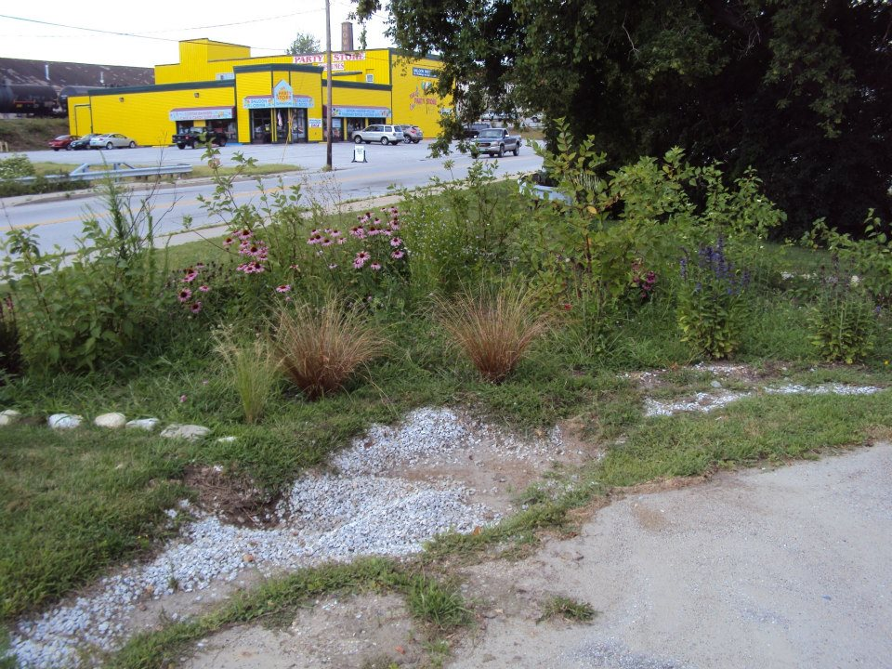
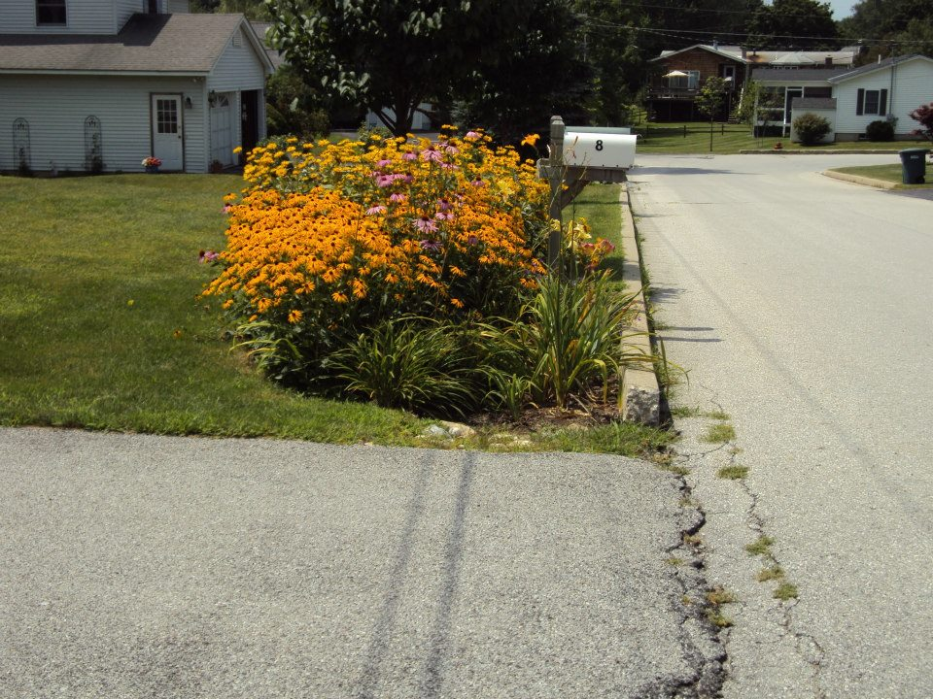
Things clogging entrance
Grass blocking entrance
Sediment and grass blocking the water flow into the garden
Notes:
As stormwater enters these systems through the inlet, it slows down and drops materials it was carrying. This can include road gravel, sediment, and seeds. Floatable particles usually stay in suspension until the water enters the planting bed, stops moving through and starts to drain.
There are various issues that occur when the sediment drops out at the top of the inlet. The sediment can cause the entrance to become clogged or blocked, only allowing limited amounts of stormwater to enter the system or totally diverting the stormwater from entering the system.

Slide 4
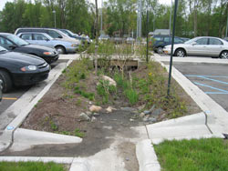
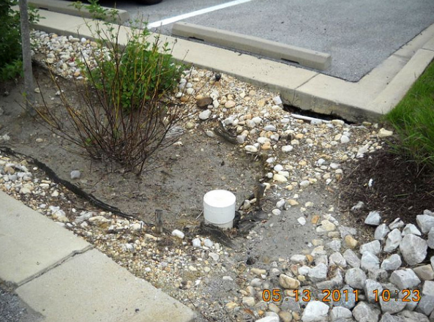
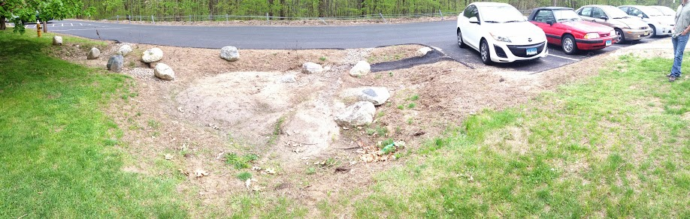
Sediment flowing in to garden with water
Sediment entering the garden
Sediment in the garden
Notes:
Sediment can also drop out within the inlet. Here, it can smother the plants within a vegetated swale, can block the water from continuing through the system or can cause erosion at the top of the planting bed.
If the sediment enters the garden, it can smother the vegetation of the planting bed itself. If this occurs repeatedly, or if the system is installed in an area with high amounts of sediment, a forebay can be installed at the base of the inlet, with a small ponding area and a low check dam. This allows sediment to be easily and efficiently removed and cleaned, compared with the task of removing sediment from the planting bed.

Slide 5
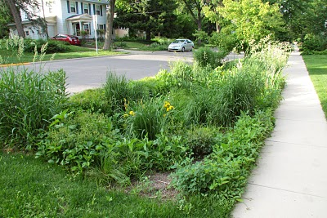
Invasive Plant & Weed Identification
The plant volunteers we want and ones we don’t
Notes:
Planting layouts often change from the original design after bio-retention systems are installed, due to the way plants grow and spread. New plants are introduced to the system and other plants die out.

Slide 6
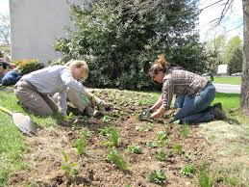
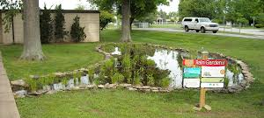
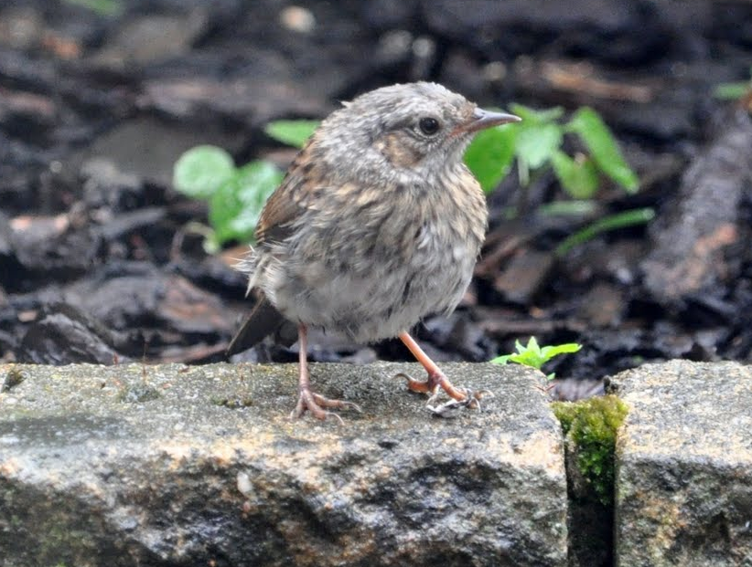
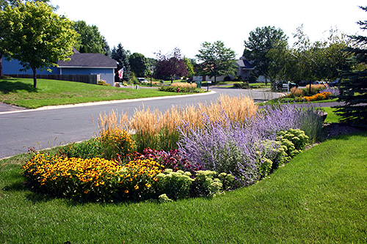
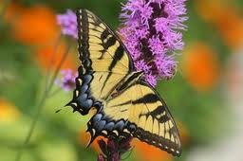
What happens after planting
Small plants spaced throughout the garden.
Open areas are left for the plants to grow into.
It rains, stormwater fills the garden.
Along with stormwater seeds, plant parts and other plant material enters the garden
Plants start to grow and get bigger
Other animals start to visit the garden, hang out on the plants start adding to the garden
Notes:
Small plants called plugs are planted in the planting bed of bio-retention system. They are given ample space to grow and expand to fill in the garden over time.
Over time as the water collects in the system, other materials are carried into the planting bed including seeds and other plant parts.
As the plants grow, wildlife start spending time in the garden, leaving plant seeds that stick onto animal fur and via bird droppings. Seeds can also blow in from near by areas. In time there may be a mix of different plants growing in the system that were not originally planted.

Slide 7
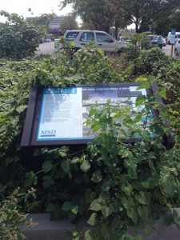
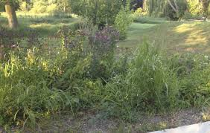
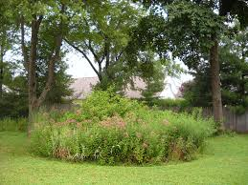
Here come the weeds….
Decisions to be made:
  How do I want this garden to look, prim and neat or natural and wild
  Are there plants in there that could impact streams rivers or woods near by?
  How much maintenance to I want to do to keep this garden exactly the same as it was designed?
Notes:
Management decisions must be made by the bio-retention owner, depending on how they would like their system to ultimately look. Plants grow, spread, die back and new ones are frequently added to gardens. The owner must decide how close to the original design they would like to keep the garden.
Function will always trump aesthetics. It is a priority that these systems be highly functioning, with good plant cover to ensure deep roots that direct stormwater into the ground.
Some systems located at highly visible areas may require more plant maintenance than those within natural landscapes in a park. But all systems should be monitored for plants that will impact other natural systems, including streams and rivers and woodlands.
The maintenance crew may need to determine how the presence of new plants may impact the sustainability of the original plant community present in the garden.

Slide 8
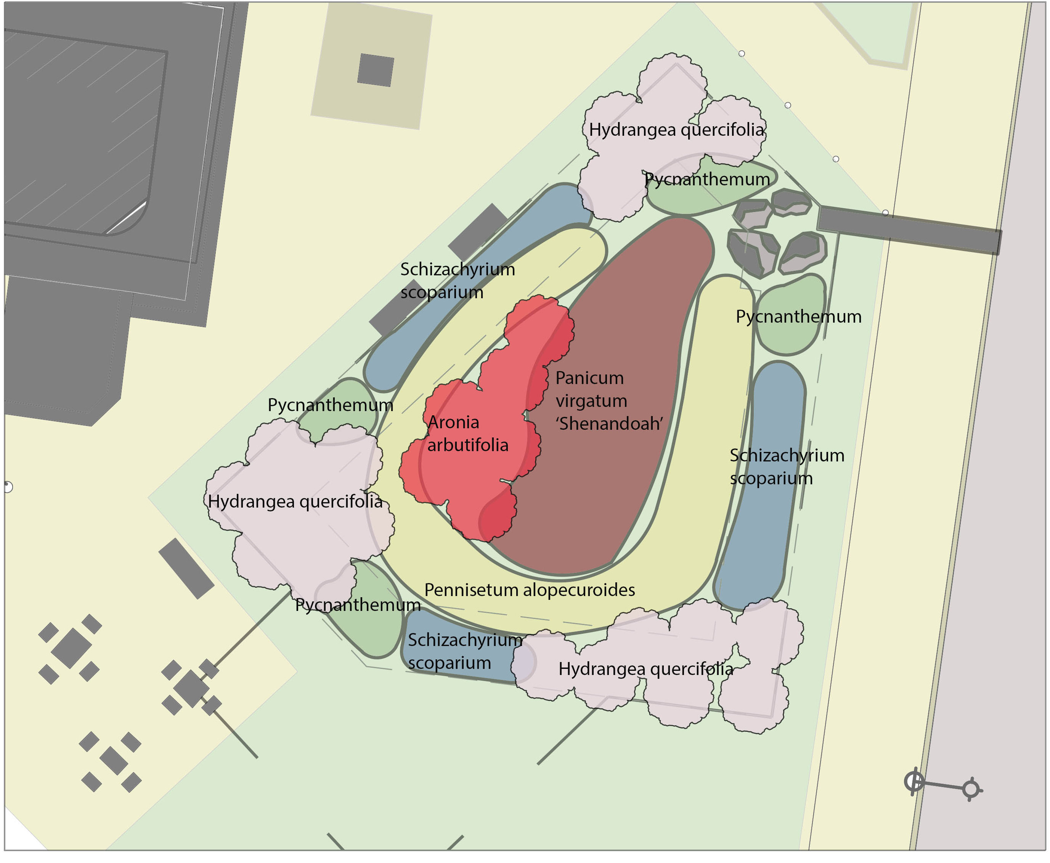
What do we plant in a rain garden?
How do we know if it should stay or go?
Notes:
What if it’s your first time visiting a particular bio-retention system and you do not know what the original planting plan was? Following are some common characteristics that identify plants selected for a rain garden or bio-retention system.

Slide 9
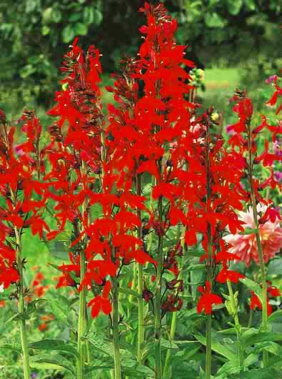
Perennial
Plant will live for many years.
Does not die off with frost like an annual plant such as a petunia.
The plant gets bigger every year.
Notes:
Bio-retention plants are typically: Perennials

Slide 10
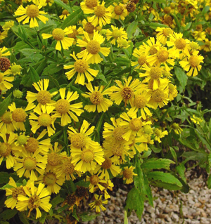
Tolerant to both drought and wet feet
Once established, can handle extended periods of time without water but can also take occasional inundation (soils are saturated after a rain event).
Notes:
They are tolerant to both drought and wet soils. This is especially important in urban gardens with sandy soils.

Slide 11
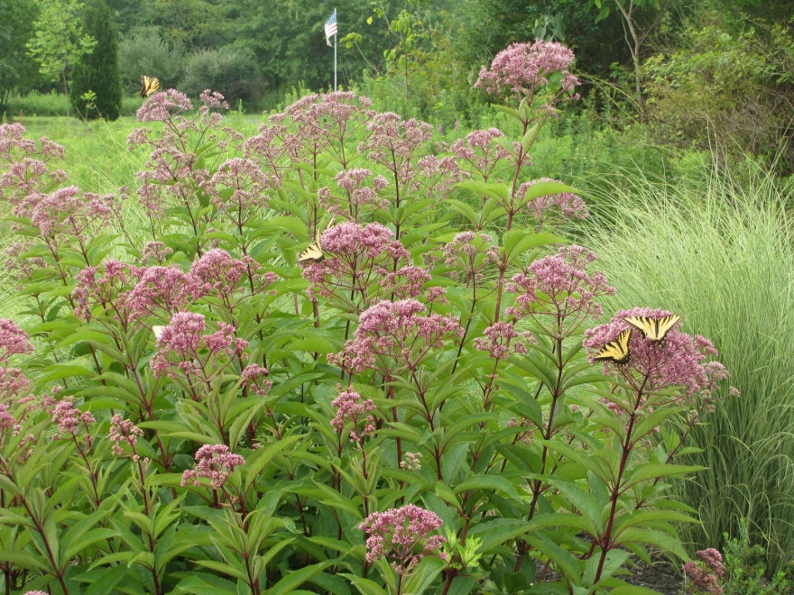
Plant Height- taller than the depth of ponding
Plant is rigid and upright.
Doesn’t require staking to stand up.
The majority of the plant is taller than the depth of stormwater that will pond in the garden.
Notes:
Plants are usually taller than the ponding depth of the planting bed. Thus they will not become submerged during an extended rain event.

Slide 12
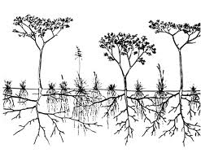
Deep rooted
Plants that have dense deep roots that penetrate deep into the soil to guide stormwater down into the ground.
Notes:
Plants typically have deep roots keeping the soils loose to help direct the stormwater into the ground, deep into the soil.

Slide 13
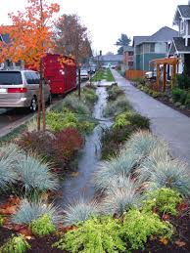
Seasonal Interest
At least one plant that is showing its stuff all year round.
Beautiful blooms, interesting foliage, early spring blossoms and dynamic fall colors or bark in the winter.
Notes:
Plant layouts usually have attractive seasonal interest, with plants blooming all season long and some fall and winter features that will attract the eye.

Slide 14
Non-native Invasive Plants
Non-native plants that have an adverse impact on habitats or eco-regions where they are introduced.
Ecological impacts include:
  Disturbing a habitat by dominating and out competing native plants for its spot/role in the habitat.
  Providing little to no benefit to the animals/plants within habitat or eco-region.
  Altering the components of the habitat including the soils and presences animals/plants within the habitat
Notes:
Plants not originally planted in the system need to be monitored to ensure that invasive plants have not become established in the planting bed, where they will negatively affect the surrounding landscape and natural areas.

Slide 15
Weed Plant
Not planted by the gardener;
Not valued where it is growing;
Usually of vigorous growth that tends to overgrow or choke out more desirable plants.
Ex. Dandelions, crab grass in a garden, broadleaf and plaintains
Notes:
Depending on how pristine the garden appearance must be maintained, varying levels of weed removal will be necessary. You do not want weeds to become the dominate plant within these systems.

Slide 16
Non-native Invasive Plants and
Common Weeds you may find in bio-retention areas
Notes:
Here are some common invasive plants and weeds found in both wetlands and dry bio-retention systems.

Slide 17
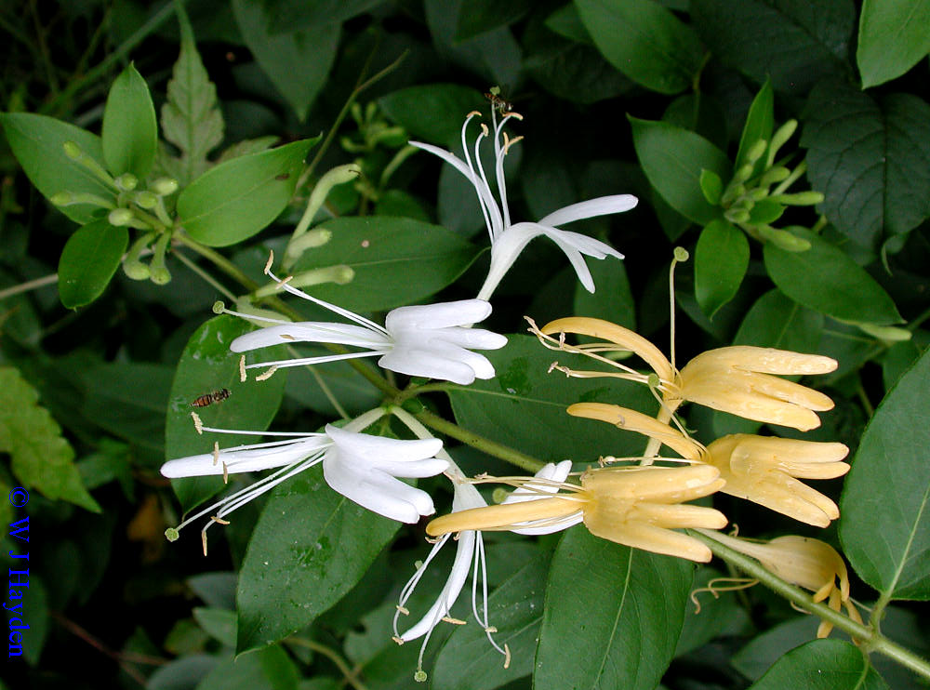
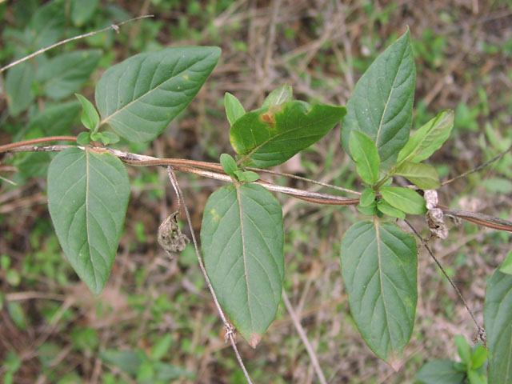
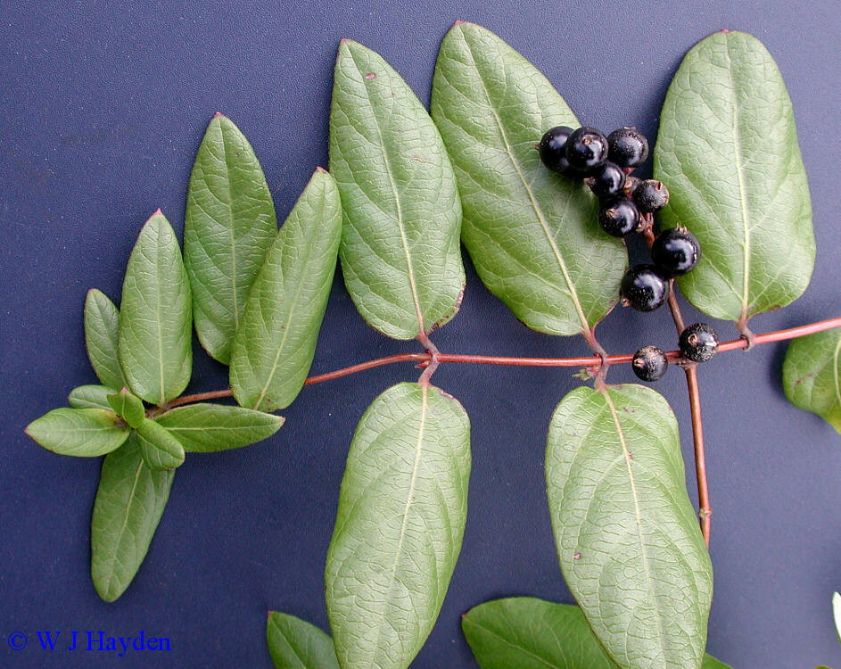
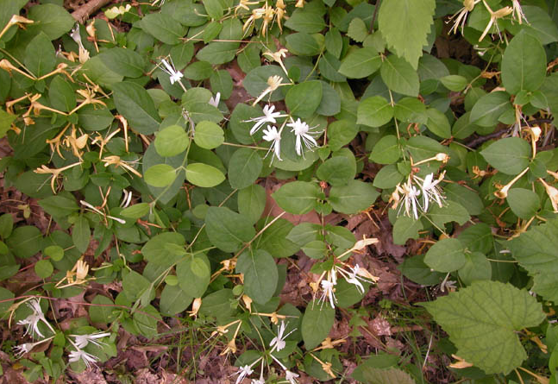
Botanical Latin name:
Common name:
Lonicera japonica
Japanese Honeysuckle
INVASIVE plant
Notes:
Management:
Cut and pull out the entire root. Do this prior to this plant going to seed to prevent the seeds from spreading the plant.

Slide 18
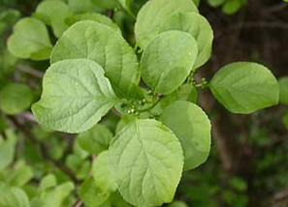
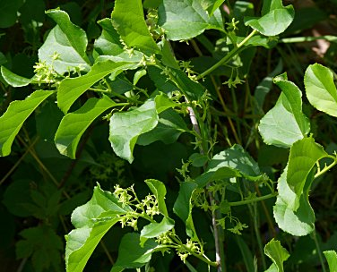
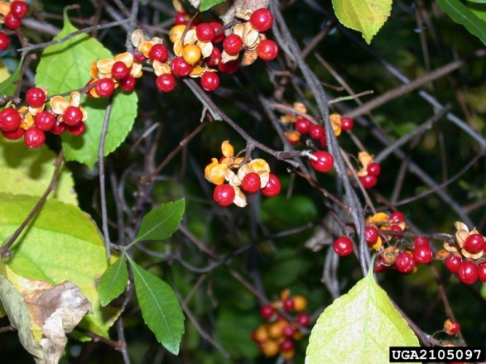
Botanical Latin name:
Common name:
Celastrus orbiculatus
Oriental Bittersweet
INVASIVE plant
Notes:
Management:
Cut and pull out entire root prior to this plant going to seed.

Slide 19
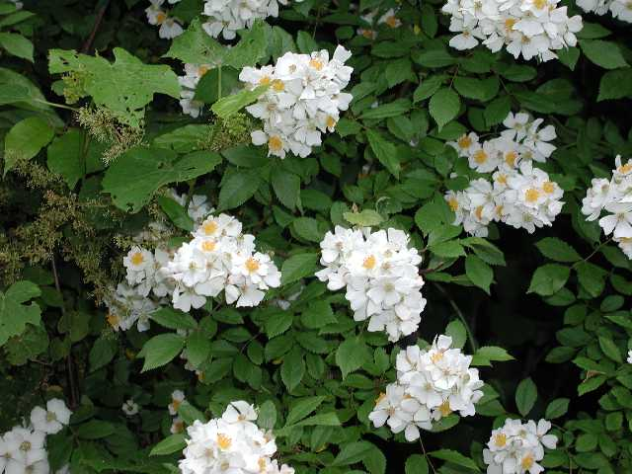
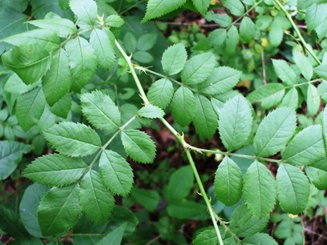
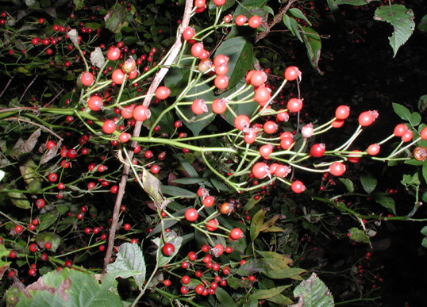
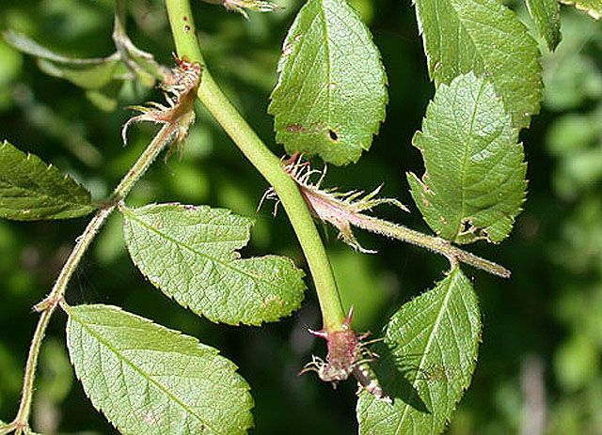
Botanical Latin name:
Common name:
Rosa multifora
Multiflora Rose
INVASIVE plant
Notes:
Management:
For small infestations - Cut and pull out entire root prior to this plant going to seed. Do not only cut the above ground portion, because this will stimulate the growth of many more shoots.
For large infestations where the plant it has taken over a site -- Pesticide application is likely required.

Slide 20
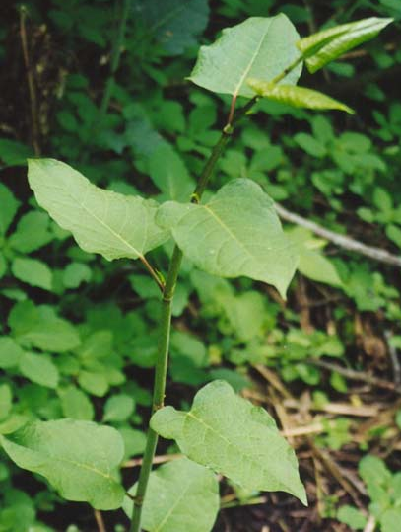
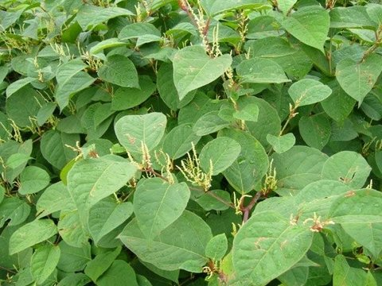
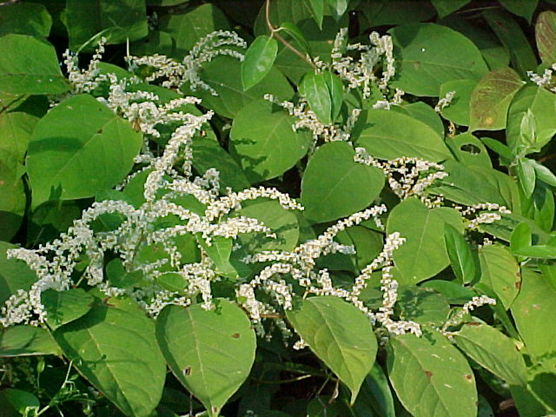
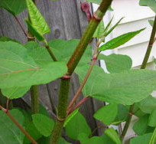
Botanical Latin name:
Common name:
Fallopia japonica
Japanese knotweed
INVASIVE plant
Notes:
Management:
Cutting the knotweed only removes the above ground portion and only serves to stimulate the growth of below-ground rhizomes. In some cases weekly mowing can eventually draw down enough of the plant’s reserves to kill it.
The best control approach is through a combination of Cutting and Herbicide application. A late spring/early summer treatment followed by early fall re-treatment is needed.

Slide 21
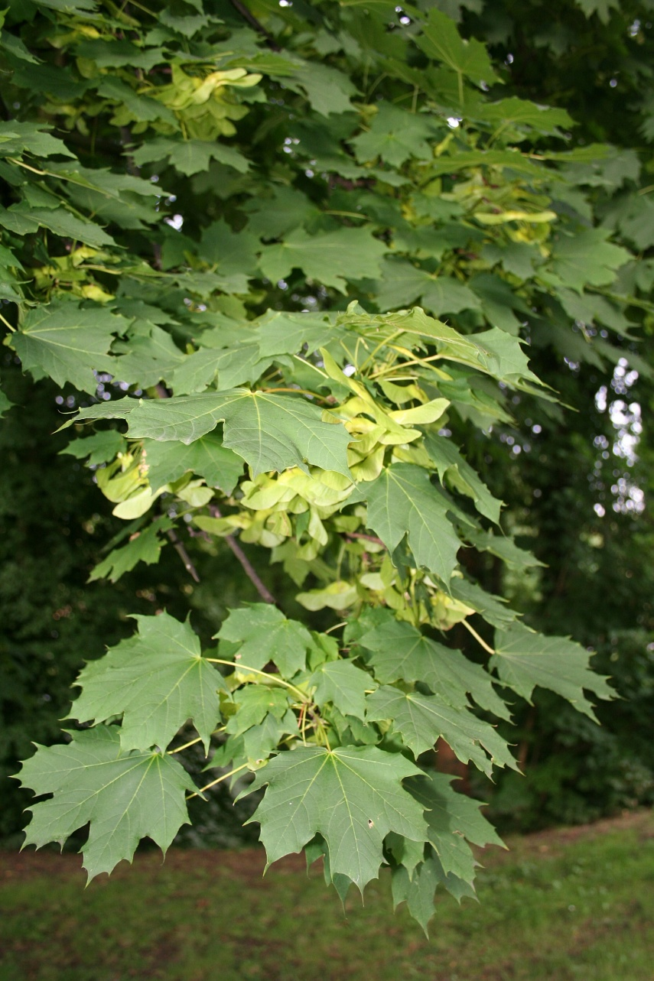
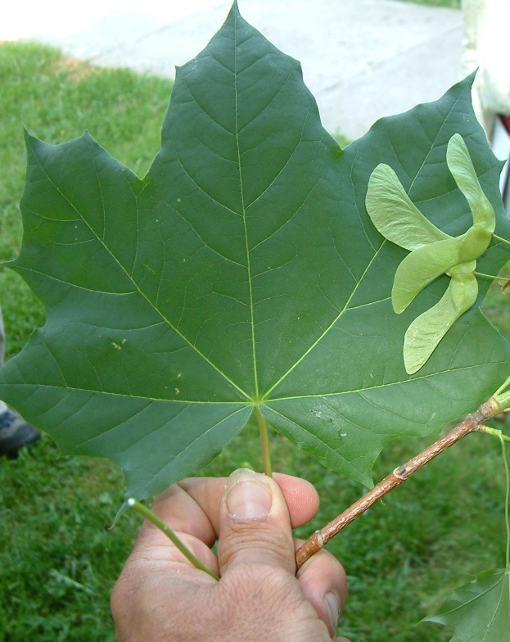
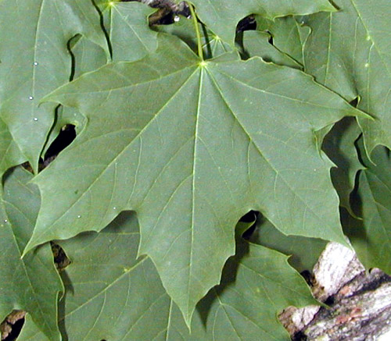
Botanical Latin name:
Common name:
Acer platanoides
Norway Maple
INVASIVE plant
Notes:
Management:
Be sure to distinguish this tree from the red maple that is commonly found growing in rain gardens. It has a wider leaf, which “bleeds” milky white when pulled from the stem.
Small trees can be hand pulled. Larger ones need to be cut down with loppers or a saw.

Slide 22
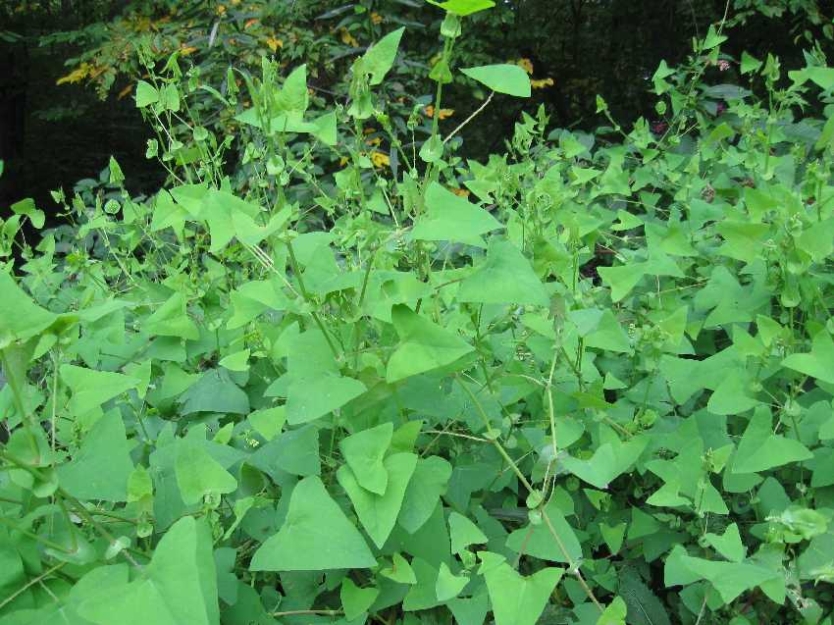
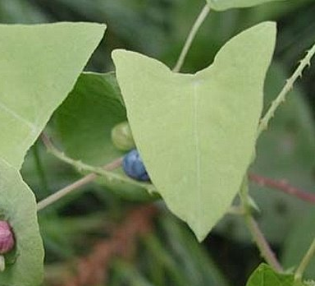
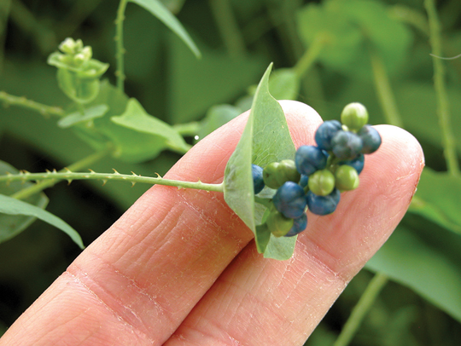
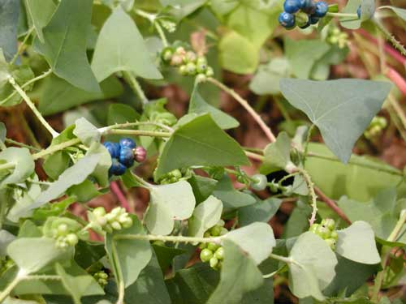
Botanical Latin name:
Common name:
Polygonum perfoliatatum
Mile-A-Minute Vine
INVASIVE plant
Notes:
Management:
Remove prior to the plant going to seed. Remove whole plant, roots and all.
Hand pull plants with gloves on, because the plant has small barbs on the stem. The vines are easily rolled into a ball for disposal.

Slide 23
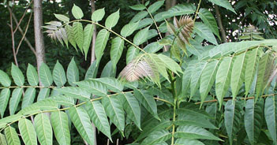
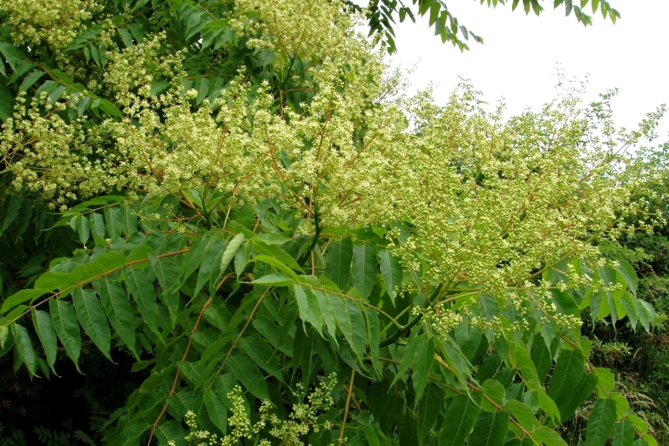
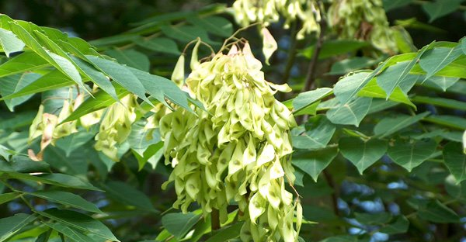
Botanical Latin name:
Common name:
Ailanthus altissima
Tree of Heaven
INVASIVE plant
Notes:
Management:
Hand pull the whole plant. A weed wrench can be used if needed.
If it is only cut down to the stump, multiple suckers will grow up from the stump. The suckers will grow into a tree within a growing season.

Slide 24
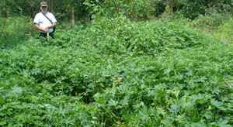
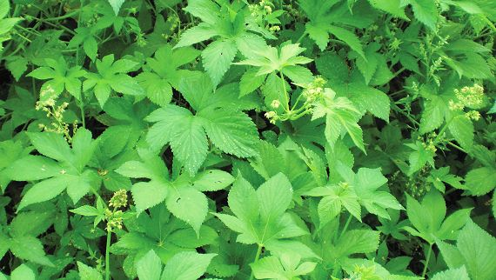
Botanical Latin name:
Common name:
Humulus japonicus Sieb. & Zucc. Japanese Hops
INVASIVE plant
Notes:
Mangement:
Hand pull the whole plant.

Slide 25





Botanical Latin name:
Common name:
Cirsium arvense
Canada Thistle
INVASIVE plant
Notes:
Management:
Remove prior to the plant going to seed. Remove whole plant, roots and all.
Hand pull the plants with gloves on, because it has small barbs on the stem.

Slide 26



Botanical Latin name:
Common name:
Aegopodium podagraria L. Goutweed, bishops weed
INVASIVE plant
Notes:
Management:
DO NOT Hand Pull. Dig up soil and plant in a large radius around the plant to capture all possible roots. Herbicide spray or cut and cover large infestations with plastic for multiple years.

Slide 27




Botanical Latin name:
Common name:
Artimesia vulgaris
Mugwort
Plant of concern-management required
Notes:
Management:
Remove prior to the plant going to seed. Remove whole plant, roots and all.

Slide 28


Botanical Latin name:
Common name:
Conyza canedansis
Horseweed / Marestail / Fleabane
Common weeds
Notes:
Early form
Management:
Hand pull prior to going to seed.

Slide 29



Botanical Latin name:
Common name:
Conyza canedansis
Horseweed / Marestail / Fleabane
Common weeds
Notes:
Fully grown plant.

Slide 30


Botanical Latin name:
Common name:
Arctium minus
Common Burdock
Common weeds
Notes:
Management:
Remove by hand with a shovel to ensure that the tap root is removed.

Slide 31


Botanical Latin name:
Common name:
Microstegium vimineum (Trin.) A. Camus
Japanese stiltgrass
Common weeds
Notes:
Management:
Hand pull for small infestations and mow for large infestations.

Slide 32


Botanical Latin name:
Common name:
Convolvulus Arvensis. L
Field Bindweed
Common weeds
Notes:
Management:
Hand pull for small infestations and mow for large infestations.

Slide 33




Botanical Latin name:
Common name:
Galium mollugo
Catchweed / Bedstraw
Common weeds
Notes:
Management:
Hand pull before going to seed.

Slide 34




Botanical Latin name:
Common name:
Senecio vulgaris
Common Groundsel
Common weeds
Notes:
Management:
Hand pull before going to seed.

Slide 35




Botanical Latin name:
Common name:
Morus alba
Mulberry
Common weeds
Notes:
Management:
Hand pull the whole plant when small. A weed wrench can be used if needed.

Slide 36




Botanical Latin name:
Common name:
Toxicodendron radicans
Poison Ivy
Native plant but beware—
Most people are highly allergic to plant’s oil- avoid touching plant.
Urushiol (oo-roo-she-all) is the oil, found in all parts of plant; leaves, stems and roots.
Never burn the plant!
Important winter food source for birds.
Wash area as soon as possible with soap and water
Other options; Tecnu & Jewelweed
Poison Ivy
Notes:
Management:
Cut vines at the base WITHOUT touching. Large infestations will need herbicide application.

Slide 37
Next up……………….
Managing surrounding landscapes to the reduce impacts on Green Stormwater Infrastructure
Notes:
This completes our overview of weeds and invasive plants.
Our next session will be on Managing surrounding landscapes to reduce their impacts on Green Stormwater Infrastructure.

Slide 38





THANK YOU TO OUR
FUNDER & PARTNERS

